Slide 1
CIS 4526 Foundations of Machine Learning
Chapter 4
Exploratory Data Analysis

Slide 2
Outline
What is Exploratory Data Analysis?
Common Tasks in EDA
How to handle missing values
Identify outliers
Find simple relationships

Slide 3
Outline
What is Exploratory Data Analysis?
Common Tasks in EDA
How to handle missing values
Identify outliers
Find simple relationships

Slide 4
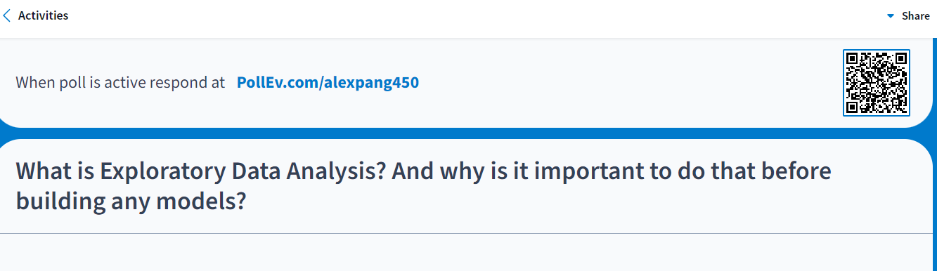

Slide 5

Credit: https://stock.adobe.com/

Slide 6
Exploratory Data Analysis (EDA)
Before building any sophisticated model, we need to do EDA first.
EDA is the first step in your data analysis. You take a broad look at patterns, trends, outliers, unexpected results and so on in your existing data, using visual and simple quantitative methods to get a sense of the story the data tell you. You’re looking for clues that suggests your logical next steps, questions or areas of research.

Slide 7
Exploratory Data Analysis (EDA)
Learn to walk before you learn how to run
Dataset Summary
Missing data
Basic Statistics
Basic Relationship
What else?

Slide 8
Outline
What is Exploratory Data Analysis?
Common Tasks in EDA
How to handle missing values
Identify outliers
Find simple relationships

Slide 9
Typical EDA Tasks
Spotting mistakes and missing data
Mapping out the underlying structure of the data
Identifying the most important variables
Listing anomalies and outliers
Test a hypotheses / check assumptions related to a specific model
Establish a parsimonious model (one that can be used to explain the data with minimal predictor variables)
Estimate parameters and figuring out the associated confidence intervals or margins of error.

Slide 10
Data Cleansing (80/20 rules)
Most data scientists spend only 20 percent of their time on actual data analysis and 80 percent of their time finding, cleaning, and reorganizing huge amounts of data
Duplicate data removed
Missing values need to be filled (or handled)
Data elements should be comparable (similar units)
Continuous values may need to be binned
Outlier data need to be removed
Ensure dataset has no systematic biases for the phenomena under analysis
Be sure dataset has enough information density

Slide 11
Outline
What is Exploratory Data Analysis?
Common Tasks in EDA
How to handle missing values
Identify outliers
Find simple relationships

Slide 12
How to handle missing values
Deletion
Pro: most easy way and no ambiguity
Con: can apply only if we have enough data, may introduce systematic bias
Imputation
Use Mean, Median or Mode
Pro: Easy to understand, ok most of the time
Con: may introduce systematic bias
For Time Series data,
Use last observed data (forward fill) (df.fillna(method=‘ffill’))
Use latest available data (backward fill) (df.fillna(method=‘bfill’))
More advanced method such as use nearest neighbor
Handling Missing Values | Kaggle

Slide 13
How to handle missing values
There is no silver bullet. That’s why a critical mind is important
Question: Give examples where
Median is preferred than mean to impute the missing value and vice versa
When you should keep outliers versus removing more them more aggressively
For time series data, when you should use fill forward versus fill backward

Slide 14



Slide 15
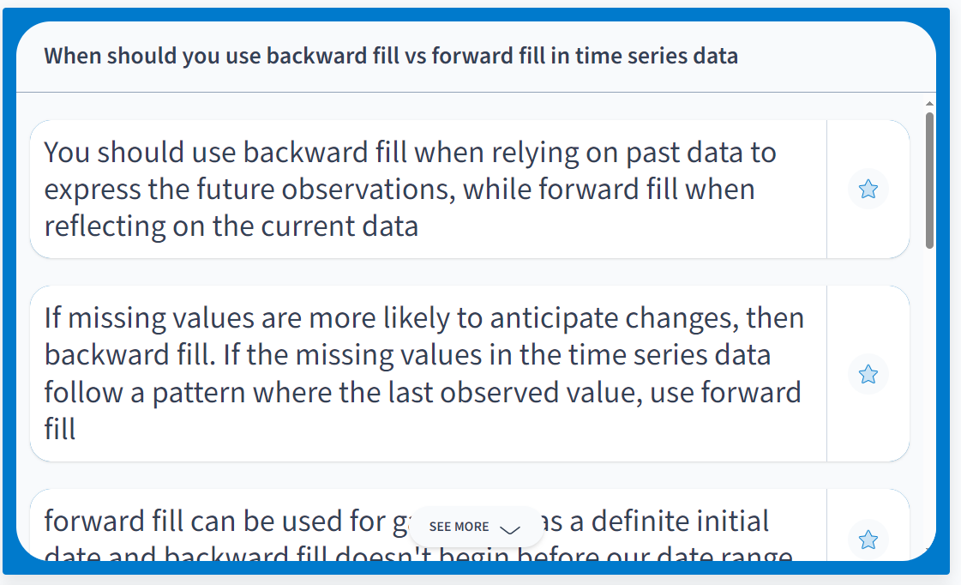
Students Answers:

Slide 16
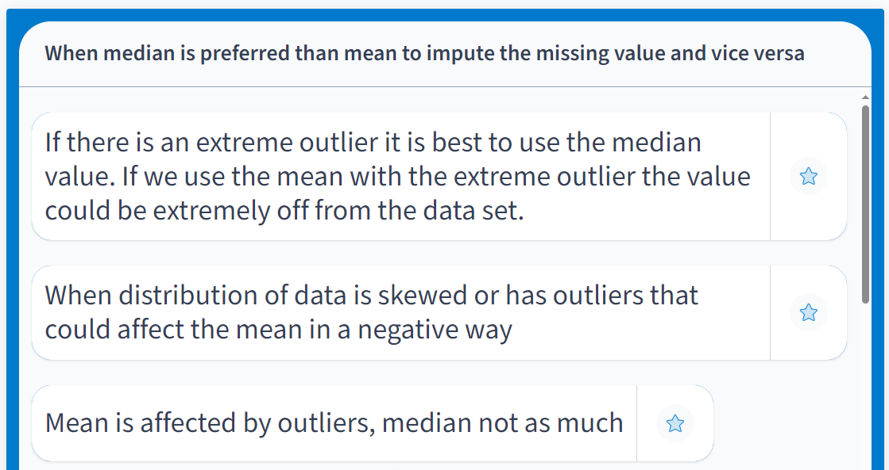
Students Answers:

Slide 17
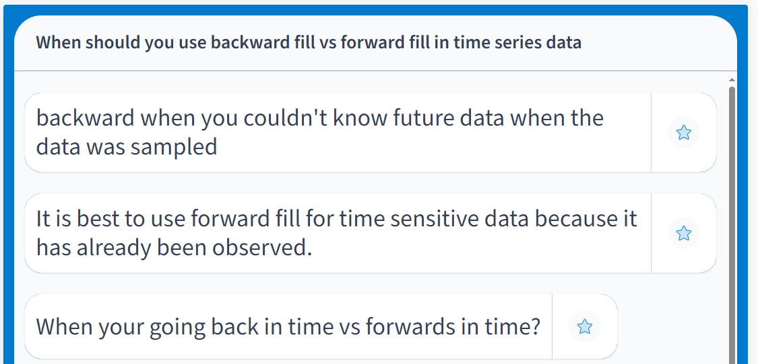
Students Answers:

Slide 18
Possible Answers
Prefer median over mean
prefer mean usually but prefer median when
you want to avoid the bias caused by too many outliers
When you should keep outliers versus removing them more aggressively
Prefer to remove outliers in general as the results will skew the results, but need to keep them when your focus is on the extreme cases
Examples: Insurance company – want to understand the catastrophic events
Prefer to fill forward usually as it does not make sense to use data from the future to predict the past. Fill backward makes sense when you know you will not have missing values and the updated value is a better reflection of the data

Slide 19
Other aspects of Exploratory Data Analysis
Ask the right questions
The goal of EDA is to explore and develop a high-level intuition and understanding of the data before we dive into any more sophisticated models

Slide 20
Outline
What is Exploratory Data Analysis?
Common Tasks in EDA
How to handle missing values
Identify outliers
Find simple relationships

Slide 21
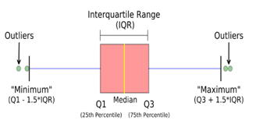
What define outliers?
Use Boxplot
“real outliers, bad data”
“real outliers, bad data”
“standard outliers”
“standard outliers”
Do not systematically remove the standard outliers
x > 3 standard deviation or x > Q3 + 1.5*QR

Slide 22
Exploratory Data Analysis
Learning by doing

